Slide 1
WHERE IS THE USA ?
Lindsey Jones, Lauren DeLaune,
Rachel Long, and Kelly Hudson

Slide 2
The World is Vast and Comprised of Many Nations
The word is enormous, and is filled with many interesting nations, peoples, and cultures
It is important to learn about the different nations and cultures, and appreciate their uniqueness
Let’s begin by learning about YOUR nation … the United States of America !
Can you find the United States on this map ?

Slide 3
The United States is in the Western Hemisphere
The world is commonly divided into two hemispheres – the Eastern and Western
The United States is part of North America, which is located in the Western Hemisphere
The United States shares the Western Hemisphere with South America. Can you find it on the map ?

Slide 4
The United States is part of North America
The United States shares North America with Canada, Mexico, and Central America
Canada borders the United States to the north
Mexico borders the United States to the south
The United States is bordered by two (2) oceans. Can you name them ?

Slide 5
Let’s Take a Closer Look at the USA …
Now that you know where the United States is in the world, let’s take a closer look at our country
Did you know that our country is divided into regions ? How many ?
Did you know that our country is divided into states ? How many ?
Let’s move on to find out more !
Hi ! I’m Sam ! I’m excited that you are learning about my home, the United States of America ! Throughout this lesson, I’ll pop-up every now and then to encourage you and provide you helpful hints. Let’s get started !

Slide 6
The United States of America
The United States (also known as the ‘USA’, ‘US’, or ‘America’) is comprised of 50 states
The states are commonly divided into five (5) separate regions
These states within these regions have many commonalities, including climate, history, and culture
Can you locate your state ?
In what region is your state located ?

Slide 7
Know the Regions of the United States !
Watch the Video !
Instructions:
Click on the ‘Play’ icon (>) to launch the video and learn more about the regions of the United States
You may want to watch the video more than once, taking notes so that you can study states and capitals that are new to you
Learn the Regions of the United States !

Slide 8
The United States of America
As we mentioned previously, the United States is comprised of 50 states
48 of the 50 states are in the Continental United States, which means they are all connected on one land mass
Two (2) of the 50 states are not connected to the others. Can you name them ?

Slide 9
Know your States and Capitals !
Watch the Video !
Instructions:
Click on the ‘Play’ icon (>) to launch the video and learn more about the states and their capitals
You may want to watch the video more than once, taking notes so that you can study states and capitals that are new to you
Learn your States and Capitals !

Slide 10
Now That You Know More About the USA …
Now that you know more about the United States, let’s practice what you’ve learned
Do the ‘Know Your States’ activity on the next slide to see how much your learned about your country !
Good luck and have fun !
Wow ! You’ve really learned a lot ! Let’s see how many states you can label on the ‘Know Your States’ activity sheet on the next slide. Not to brag, but I can name all 50 states. Let’s see how you do ! Have fun & good luck !

Slide 11
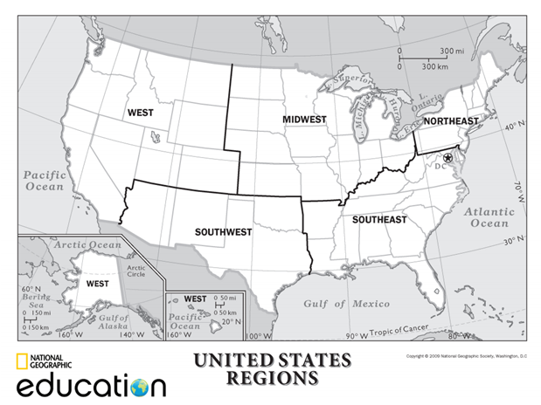
Know Your States !
Instructions:
The five (5) regions of the United States are indicated on the map
See how many of the states you can identify by writing the name of the state on the corresponding state shape
When you’re done, check your work against the map on slide two (2) of this presentation

Slide 12
Great Job ! Now, let’s learn some more !
If not already assigned, select two (2) states that interest you
Use the internet to research these states and learn more about them
Use Libre Office to prepare a one-page paper on your assigned (or chosen) states
Be prepared to share your paper with the class !
Helpful Hint: Bring an item or picture that represents your assigned (or chosen) states, and/or dress up like a historical figure or regionally appropriate occupation (farmer, surfer, etc.) or a celebrity from your assigned (or chosen) states. Be creative & have fun !

Slide 13
Classroom Activities and Assessment Criteria
Classroom Activities
Students will come to class ready to participate in classroom discussion and assignments
Students will present their research to the class on their assigned states/region in a 1-2-minute presentation
Students will be divided up into groups based on their assigned states/regions of the US and will be given instructions for a group research project/presentation using Libre Office
Students will create a tentative plan/schedule for their research project/presentation to be completed in class over the next 3 class meetings
Assessment Criteria
Students will turn in their one-page paper upon entering class
Students will be given a bellwork quiz inserting states into various regions of the US
Students will participate in an interactive, classroom-wide quiz on states/regions
Students will be graded on their state/region presentation to the class, and their group research project/presentation

Slide 14
Where Is the USA ?
This lesson was created to enhance your knowledge of our country and our place in the world
This lesson was thoughtfully created with graphics and visuals to make the lesson more interesting and visually-appealing
This lesson was structured to convey key aspects of the topic in a time-efficient and cost-effective manner
Created By: Lindsey Jones, Lauren DeLaune, Rachel Long, and Kelly Hudson

